Slide 1
Chapter 8: The Financial Sector Crisis and Its Aftermath
“Ideas, knowledge, art, hospitality, travel – these are the things which should of their nature be international. But let goods be homespun whenever it is reasonably and conveniently possible; and above all, let finance be primarily national.”
…John Maynard Keynes

Slide 2
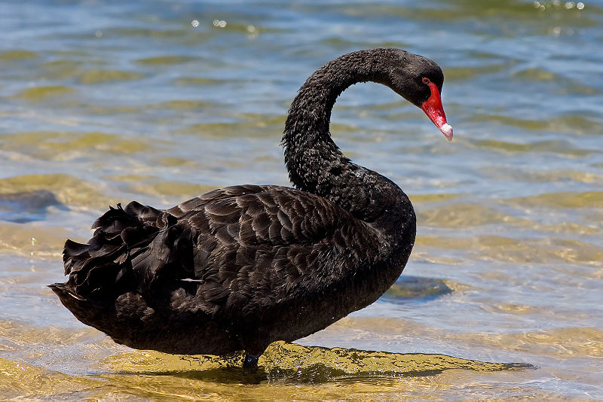
Patterns of Financial Crises
“Contrary to conventional wisdom, crises are not black swans but white swans: the elements of boom and bus are remarkably predictable.”
Notes:
A black swan, a member of species Cyngnus Atratus, remained undocumented in the West until the 18th century. Wikipedia

Slide 3
Nassim Taleb’s Criterion for Identifying a Black Swan Event
The event is a surprise (to the observer).
The event has a major impact.
After its first recording, the event is rationalized by hindsight, as if it could have been expected.

Slide 4
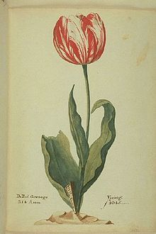
Tulip Mania
Notes:
A tulip, known as the “Viceroy,” displayed in a 1637 Dutch catalog. Its bulb cost between 3,000and 4,200 builders depending on size. A skilled craftsman at the time earned about 300 guilders a year. Wikipedia

Slide 5
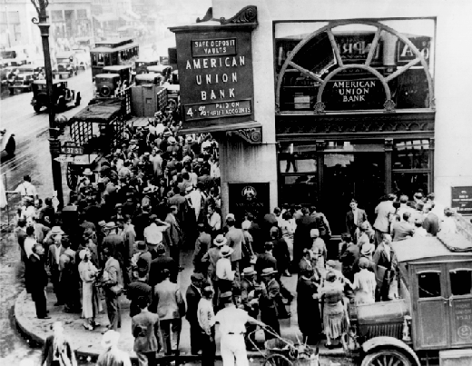
The Roaring Twenties and the Stock Market Crash of 1929
Notes:
Crowd at New York’s American Union Bank during a bank run early in the Great Depression. Wikipedia

Slide 6
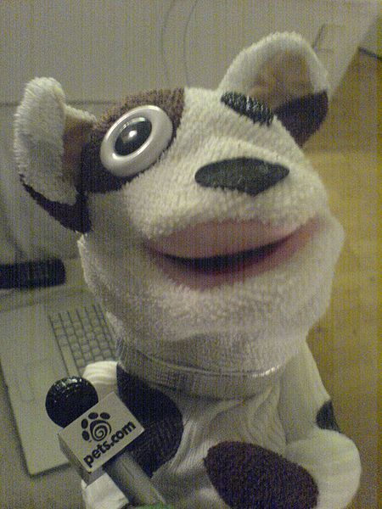
Dot-Com Bubble
Notes:
The Pets.com sock puppet was a causality of the Dot-Com Bubble. The company was founded in August 1998 and defunct in November 2000. Wikipedia

Slide 7
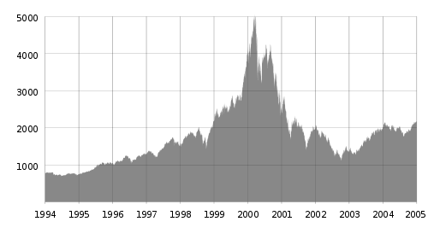
Dot-Com: NASDAQ Spiked and Fell
Notes:
The NASDAQ Composite index spiked in the late 90s and then fell sharply as a result of the dot-com bubble. Wikipedia

Slide 8
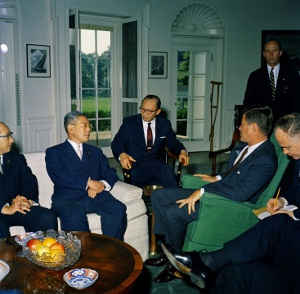
Ikeda and Kennedy, 1961
Notes:
Hayato Ikeda (seated on white sofa) meeting U.S. President John F. Kennedy (seated green chair) at the White House in June 1961. Ikeda promoted the Japanese model of bank lending to corporations. Wikipedia

Slide 9
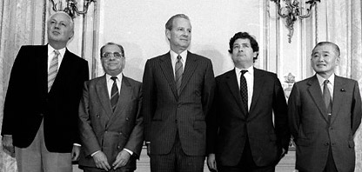
Plaza Accord
Notes:
The 1985 "Plaza Accord" is named after New York City's Plaza Hotel, which was the location of a meeting of finance ministers who reached an agreement about managing the fluctuating value of the US dollar. From left are Gerhard Stoltenberg of West Germany, Pierre Bérégovoy of France, James A. Baker III of the United States, Nigel Lawson of Britain, and Noboru Takeshita of Japan. Wikipedia

Slide 10
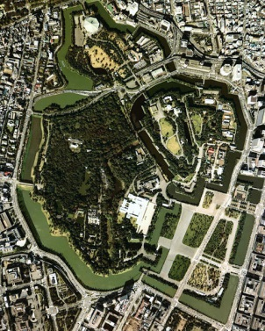
Tokyo’s Imperial Palace
Notes:
The land surrounding Tokyo’s Imperial Palace – several hundred acres in total – had by some estimates market value equivalent to al the real estate in California! Wikipedia

Slide 11
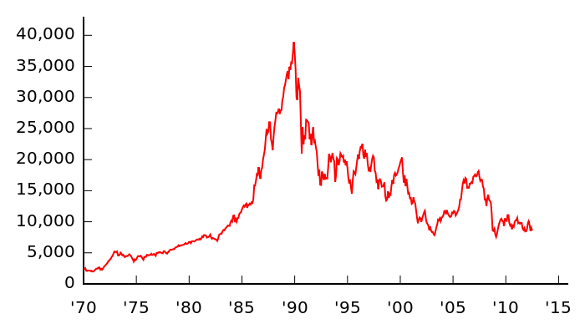
Nikkei 222, Japan’s Stock Market
Notes:
The Nikkei, Japan’s Stock Market Index, peaked on December 29, 1989 at 39,957. It closed on March 10, 2009 at 7,054. Wikipedia

Slide 12
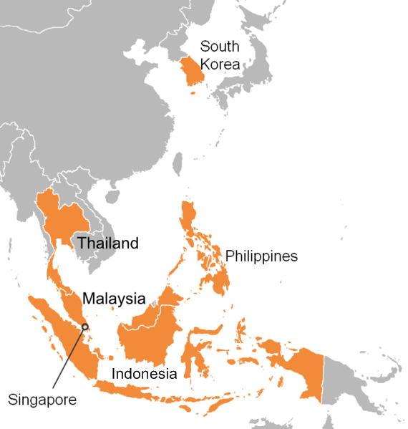
East Asian Financial Crisis, 1997-98
Notes:
The countries most affected by the 1997 Asian financial crisis. Wikipedia

Slide 13
Major Events of the Asian Financial Crisis 1997-1998
Financial liberalization – pushed by IMF & U.S. Treasury.
Foreign funds seek quick & high returns.
Over-investment, leading to a bubble.
Panicky withdrawal of funds, fall in prices.
Bailout of foreign speculators by IMF.
Collapse of real economy – recession.

Slide 14
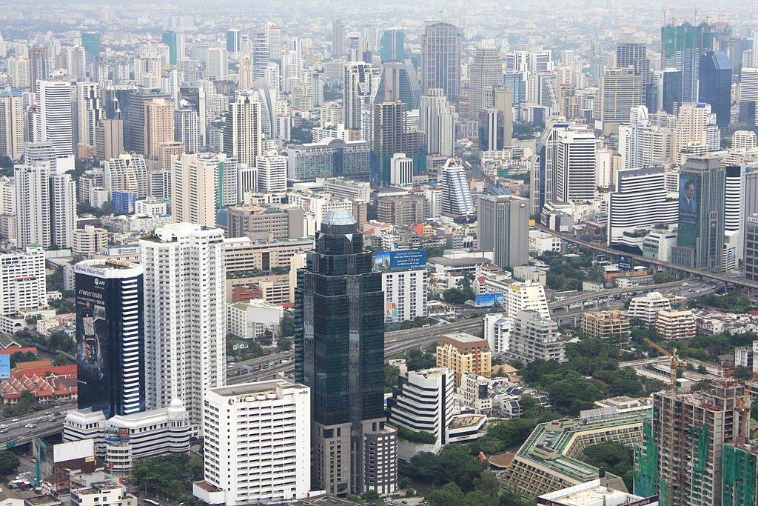
Bangkok, Thailand
Notes:
The Sukhumvit area appears as a sea of high-rise buildings in this image taken from Baiyoke Tower II, the tallest building in Bangkok. Thailand was the epicenter of the Asian Financial Crisis. Wikipedia

Slide 15
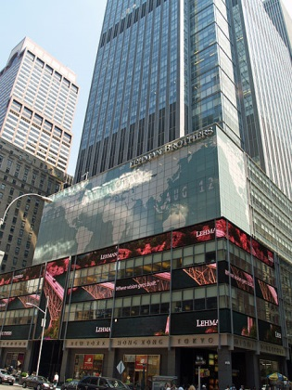
The Fall of Lehman Brothers
Notes:
The former New York City headquarters now owned by Barclays of London. Wikipedia

Slide 16
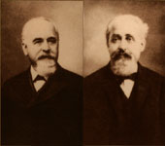
Emanuel and Mayer Lehman
Notes:
Early founders of Lehman Brothers -- Emanuel and Mayer Lehman. Wikipedia

Slide 17
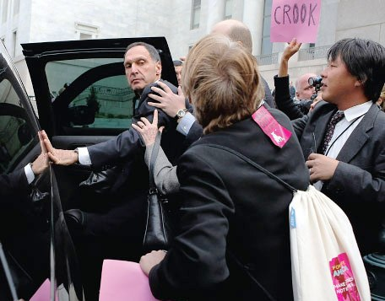
Dick Fuld
Notes:
CEO Dick Fuld, former Chair of the bankrupt Lehman Brothers, after testifying before Congress on October 6, 2008. (not Wikipedia, please do not replicate)

Slide 18
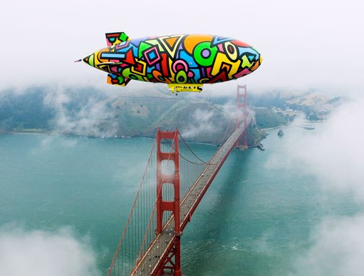
Ameriquest Blimp
Notes:
Ameriquest blimp over the Golden Gate Bridge in San Francisco, CA USA. Flying high for a while, but the whole financial industry was built on a shaky foundation. (not Wikipedia, please do not replicate)

Slide 19
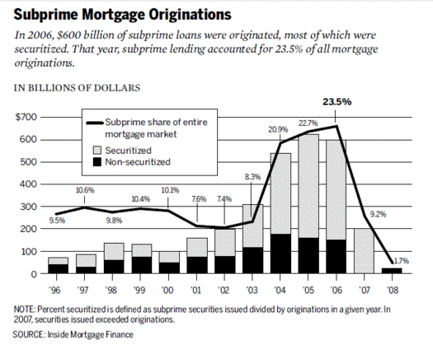
Subprime Mortgages Falling 2007
Notes:
Falling subprime mortgage lenders, one of the first to fail was New Century Financial in March 2007. Wikipedia

Slide 20
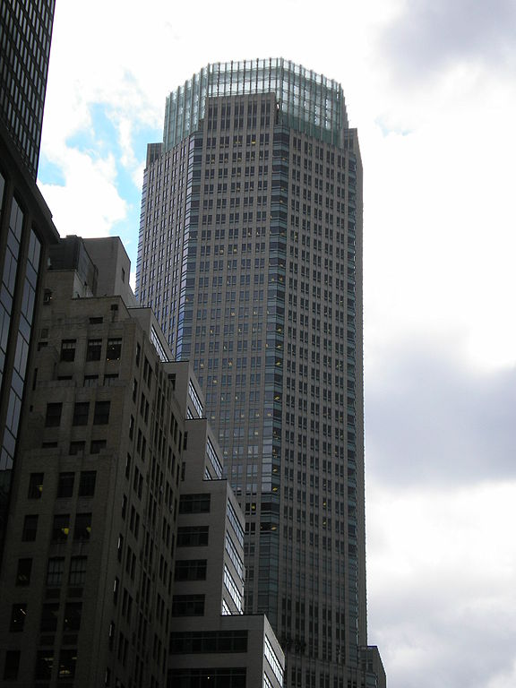
Investment Bank Bear Stearns
Notes:
Bear Stearns, the weakest of the investment banks and most highly leveraged, was the first to fall. March 2008, government orchestrated the sale of Bear Stearns to JP Morgan Chase. Wikipedia

Slide 21
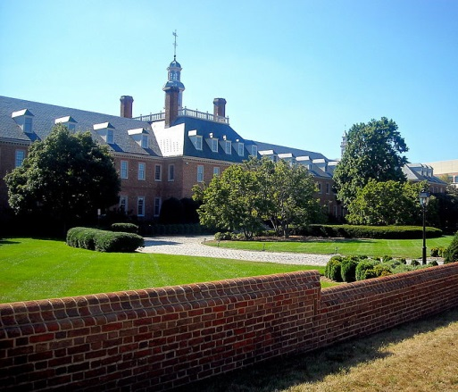
Fannie Mae, Waivered 2008
Notes:
Spring 2008 Fannie Mae needed an infusion of cash. They had leveraged themselves at 40 to 1. Wikipedia

Slide 22
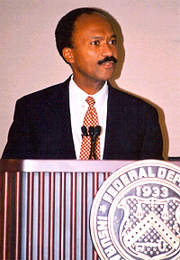
Franklin Raines,
CEO of
Fannie Mae
Notes:
Franklin Raines earned $90 million in salary and bonuses while he was head of Fannie Mae. Wikipedia

Slide 23
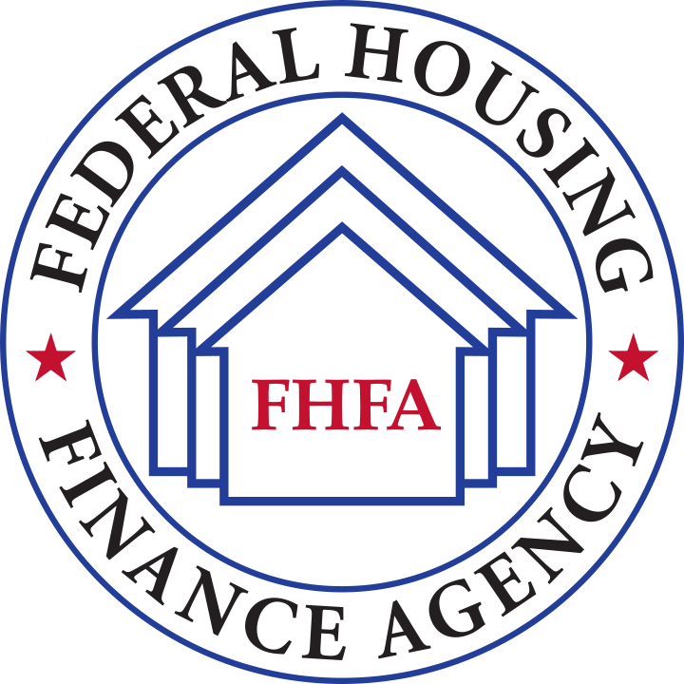
Conservatorship of Fannie Mae and Freddie Mac
Notes:
Formed July 30, 2008 to oversee the government conservatorship of Fannie Mae and Freddie Mac. Wikipedia

Slide 24
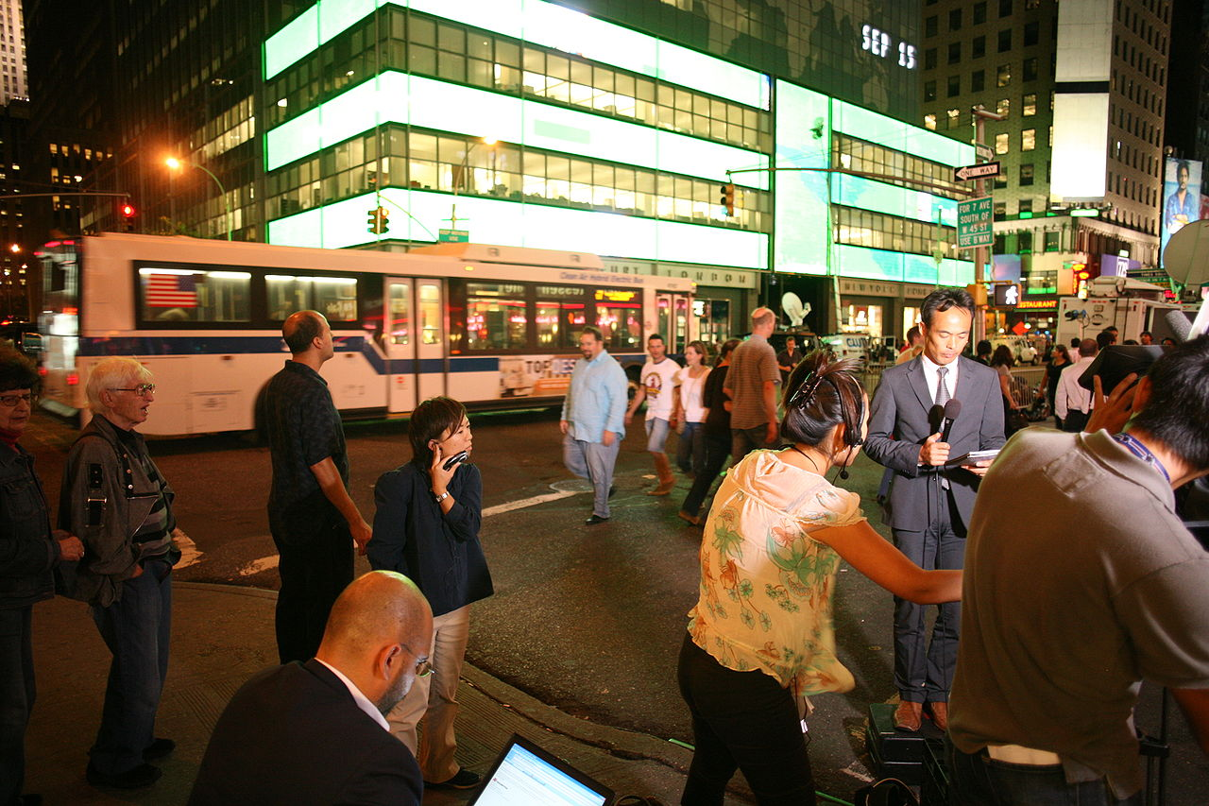
Lehman Brothers, September 15, 2008
Notes:
Lehman Brothers headquarters in New York City on September 15, 2008, the day of the collapse. Wikipedia

Slide 25
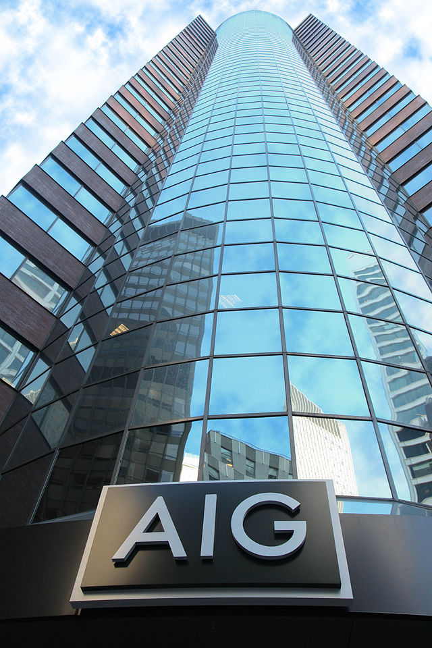
AIG Head-quarters
Notes:
The American International Building on 175 Water Street, New York City. Troubles intensified in late 2008. Wikipedia

Slide 26
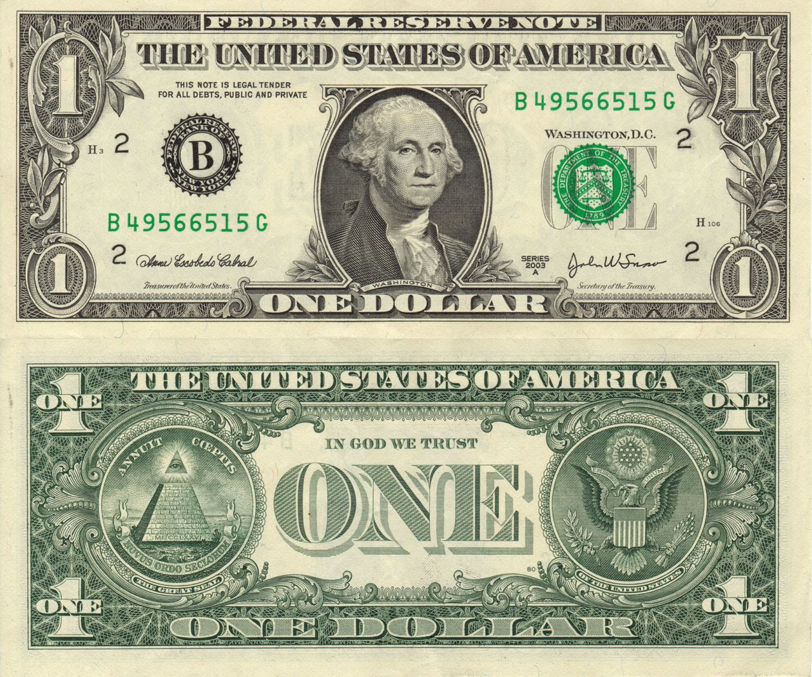
Money Market Funds:
Broke the Buck
Notes:
Reserve Primary Fund, a money market fund, was the first to “break the buck” in September 2008. Wikipedia

Slide 27
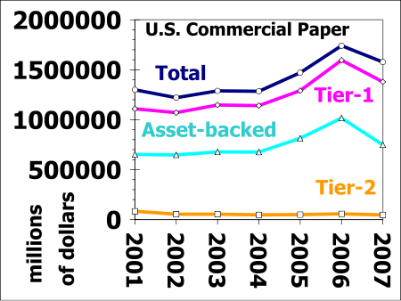
Notes:
U.S. Commercial Paper types outstanding at end of each year 2001 to 2007. Wikipedia

Slide 28
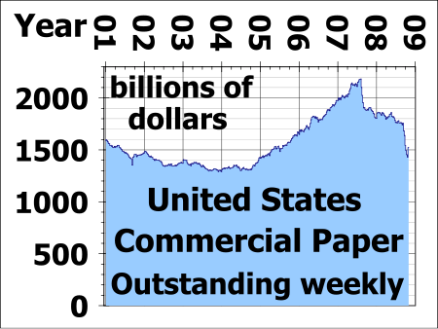
Notes:
Total U.S. CP outstanding. Wikipedia

Slide 29
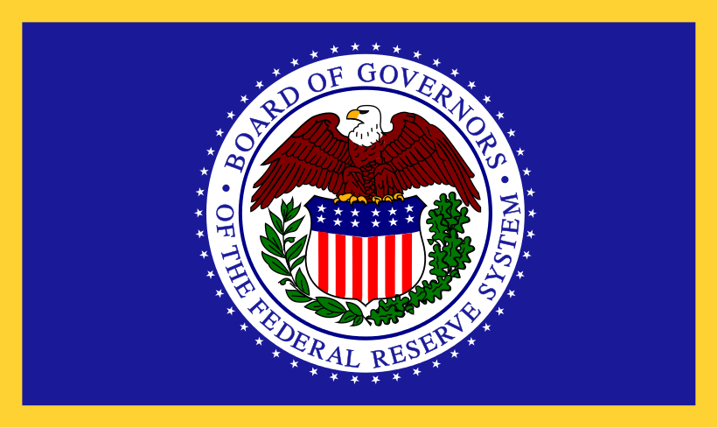
Federal Reserve Flag
Notes:
Federal Reserve stepped in to be the lender of last resort.. Wikipedia

Slide 30
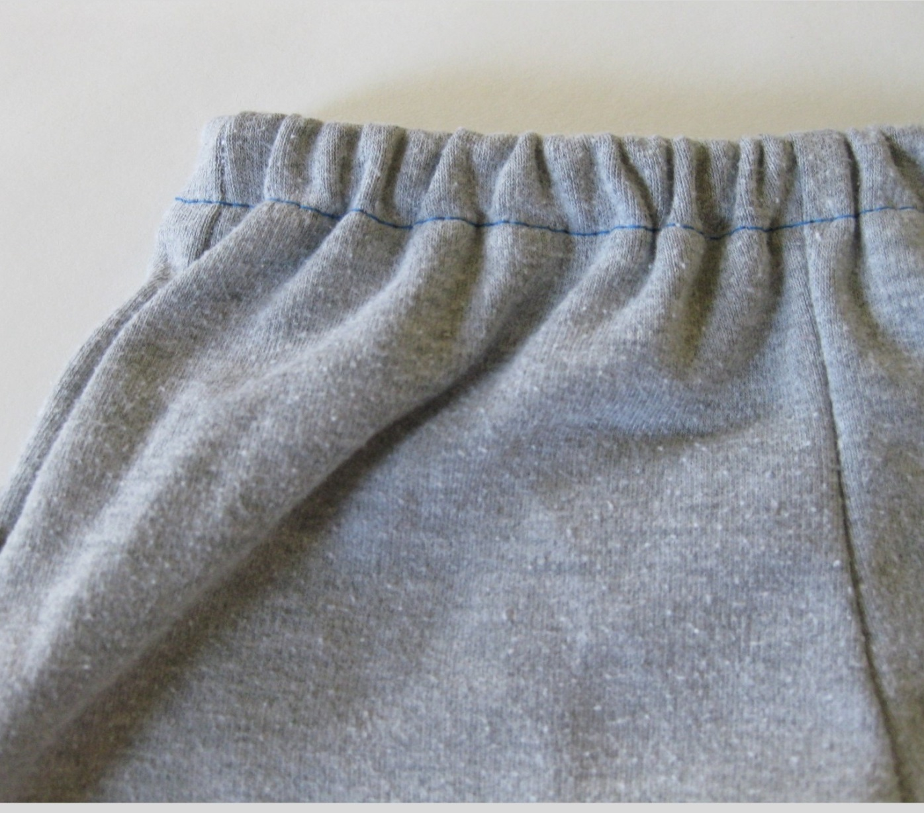
Quantitative Easing
Notes:
The Fed added lots of liquidity to the financial system. Wikipedia

Slide 31
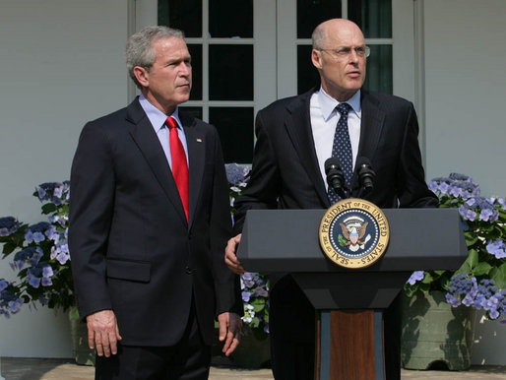
TARP
Notes:
Secretary Henry (Hank) Paulson was nominated by Present Bush (left) to be Secretary of Treasury. Paulson guided the nation through the initial states of the financial crises and was the author of TARP. Wikipedia

Slide 32
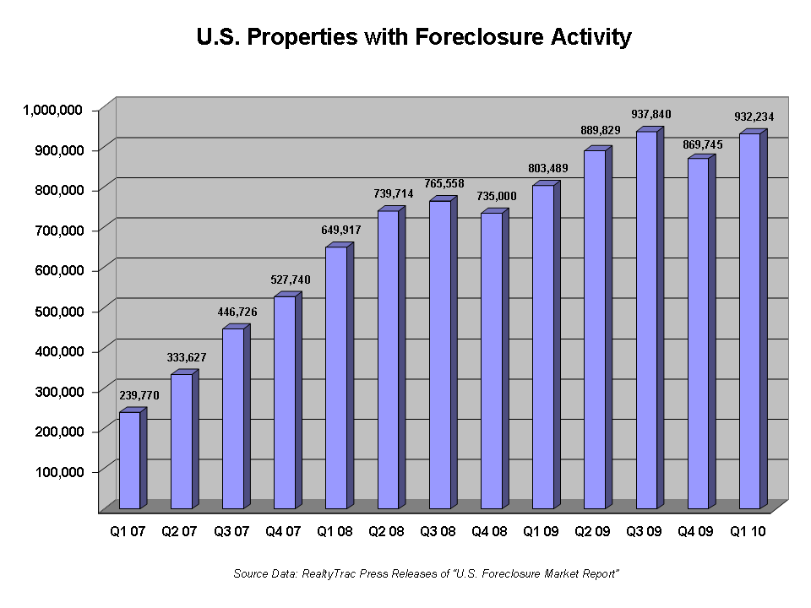
Notes:
Foreclosure activity increased after the events of the financial crisis. Wikipedia

Slide 33
The New Normal: The 5 Rs
Revolution
Restore
Reaction
Reform
Rebuild

Slide 34
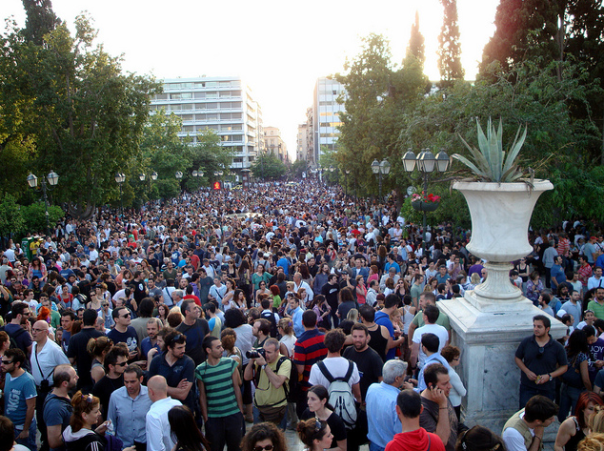
Revolution
Notes:
Demonstrators in the plaza in front of the Greek Parliament, May 25, 2011. Wikipedia

Slide 35
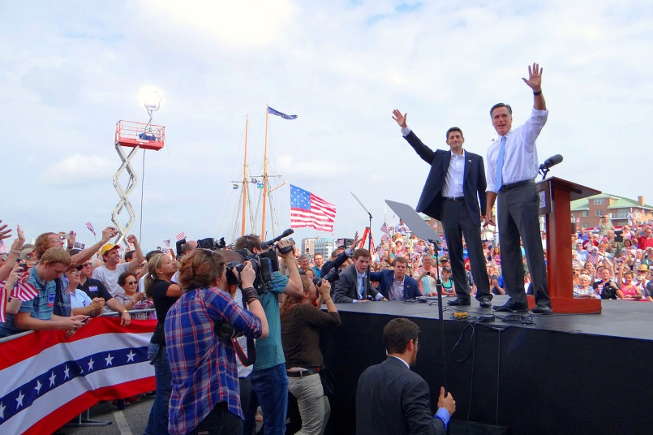
Restore
Notes:
Mitt Romney with running mate Paul Ryan in Norfolk, Virginia, during the vice presidential selection announcement on August 11, 2012. Romney emphasized restore, while Ryan embraced reaction. Wikipedia

Slide 36
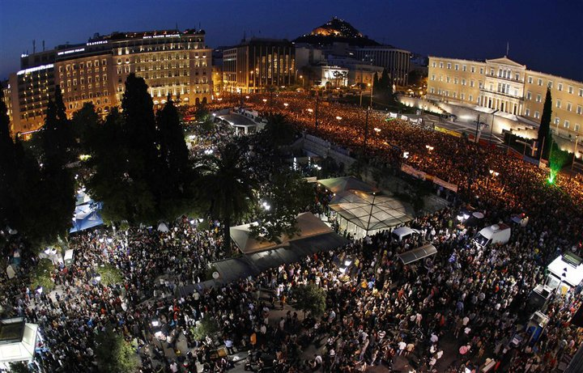
Anti-Austerity Rally, Greece
Notes:
100,000 peaceful anti-austerity protesters in front of the parliament of Greece on 29 June 2011. Wikipedia

Slide 37
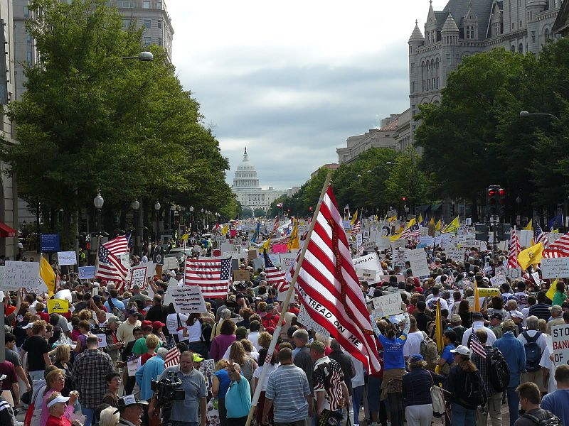
Tea Party, Austerity Rally
Notes:
Tea Party protestors walk towards the US capitol curing the Taxpayer March on Washington, September 12, 2009. Austerity Rally. Wikipedia

Slide 38
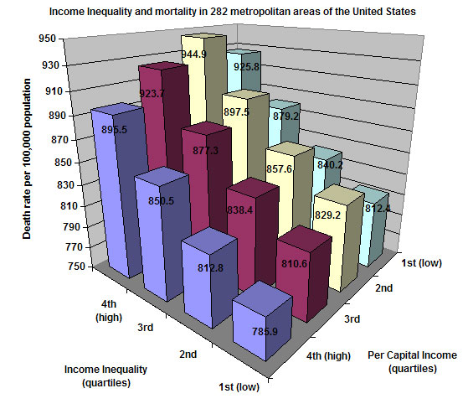
Inequality
Notes:
Income inequality and mortality in 282 metropolitan areas of the United States. Mortality is strongly associated with higher income inequality, but, within levels of income inequality, not with per capita income. Wikipedia

Slide 39
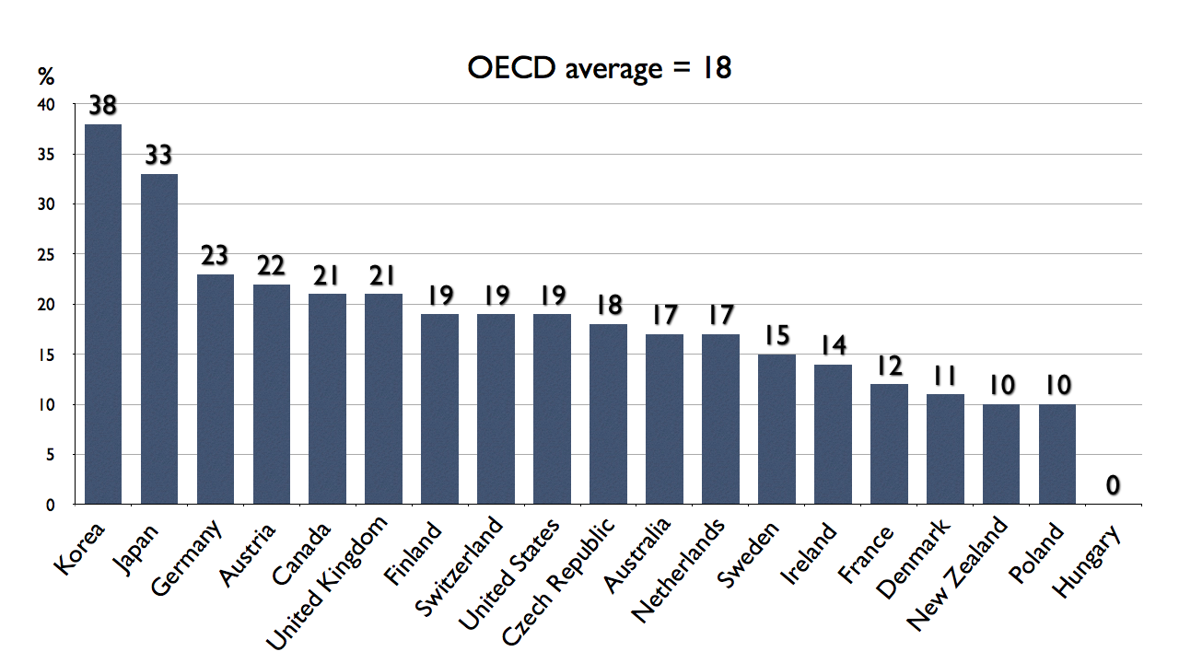
Gender Income Inequality
Notes:
The gender gap in median earnings of full-time employees according to the OECD 2008. Wikipedia

Slide 40
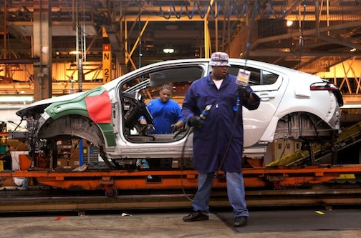
Income Inequality
Notes:
General Motors (GM) Automobile manufacturing worker has experienced a decline in wages. Wikipedia

Slide 41
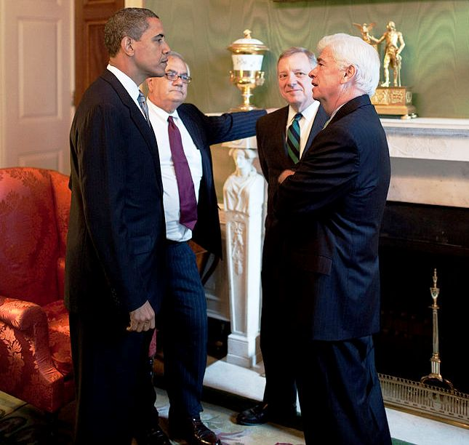
Reform: Financial
Reform
Notes:
President Barack Obama (l.) meeting with Rep. Barney Frank, Sen. Dick Durbin, and Sen. Chris Dodd, in the Green Room at the White House prior to a financial regulatory reform announcement on June 17, 2009. Wikipedia

Slide 42
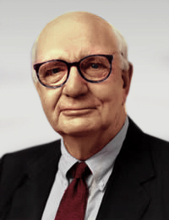
Paul Volcker author of the Volcker Rule
Notes:
The Volcker Rule refers to part of the Dodd–Frank Wall Street Reform and Consumer Protection Act, originally proposed by American economist and former United States Federal Reserve Chairman Paul Volcker to restrict United States banks from making certain kinds of speculative investments that do not benefit their customers. Wikipedia

Slide 43
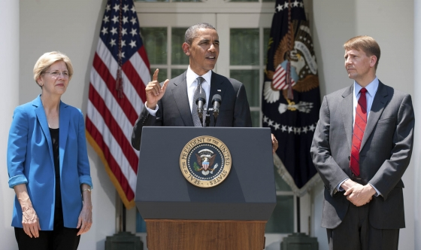
Reform: Consumer Financial Protection Bureau
Notes:
President Barack Obama announces the nomination of former Ohio Attorney General Richard Cordray, right, as the first director of the Consumer Financial Protection Bureau (CFPB) during a statement in the Rose Garden of the White House, July 18, 2011. At left is Elizabeth Warren, interim director of the CFPB and now Senator from Massachusetts. Wikipedia

Slide 44
Rebuild
Emphasizing Small and Local
Challenging the Growth Model
Renewing Public Ownership
Healing our Planet
Creating Shared Values

Slide 45
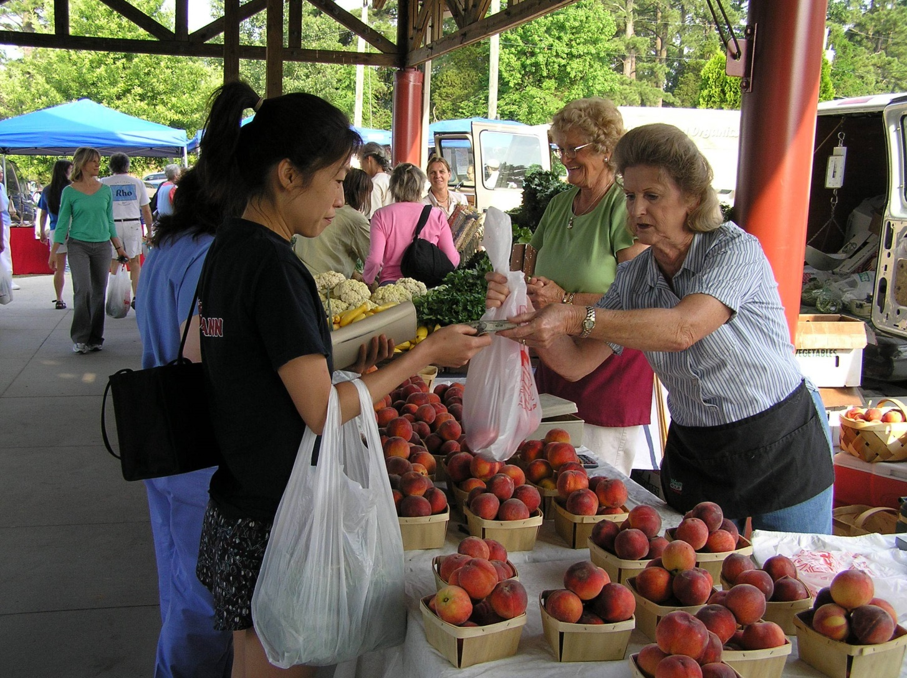
Small And Local
Notes:
A farmer’s market. Wikipedia

Slide 46
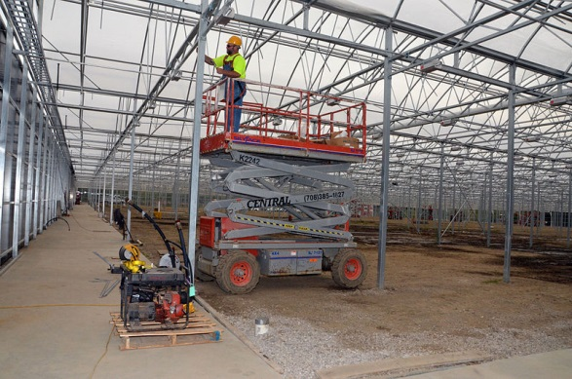
Challenging the Growth Model
Notes:
The Green City Growers Greenhouse under construction in September 2012. Green City Growers Cooperative was conceived in 2008, an entirely worker-owned, year-round, hydroponic food-production greenhouse that could supply Cleveland-are retailers and wholesales with fresh produce. Wikipedia.

Slide 47


Social Enterprises
Notes:
Fair Trade USA is an independent, nonprofit organization that sets standards, certifies, and labels products that promote sustainable livelihoods for farmers and workers and protect the environment. Wikipedia
The Grameen Bank (Bengali: গ্রামীণ বাংক) is a Nobel Peace Prize-winning microfinance organization and community development bank founded in Bangladesh.

Slide 48
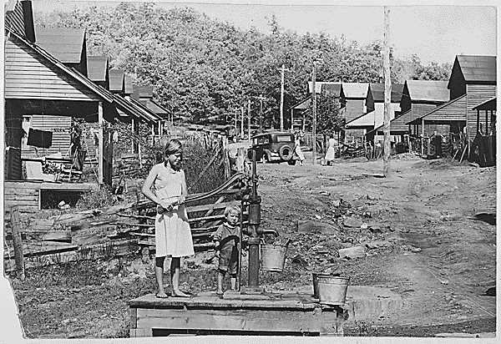
Public Ownership
Notes:
Pumping water from a well before the construction of the TVA. Wikipedia

Slide 49
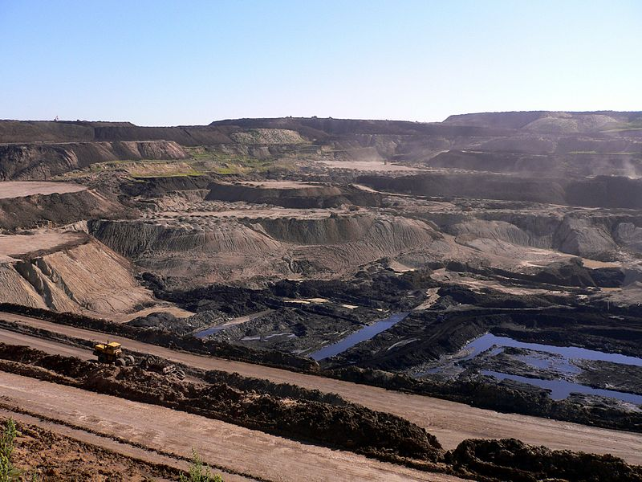
Healing the Planet
Notes:
China’s largest open-pit coal mine is located in Haewusu in the Inner Mongolia Autonomous Region. Wikipedia

Slide 50
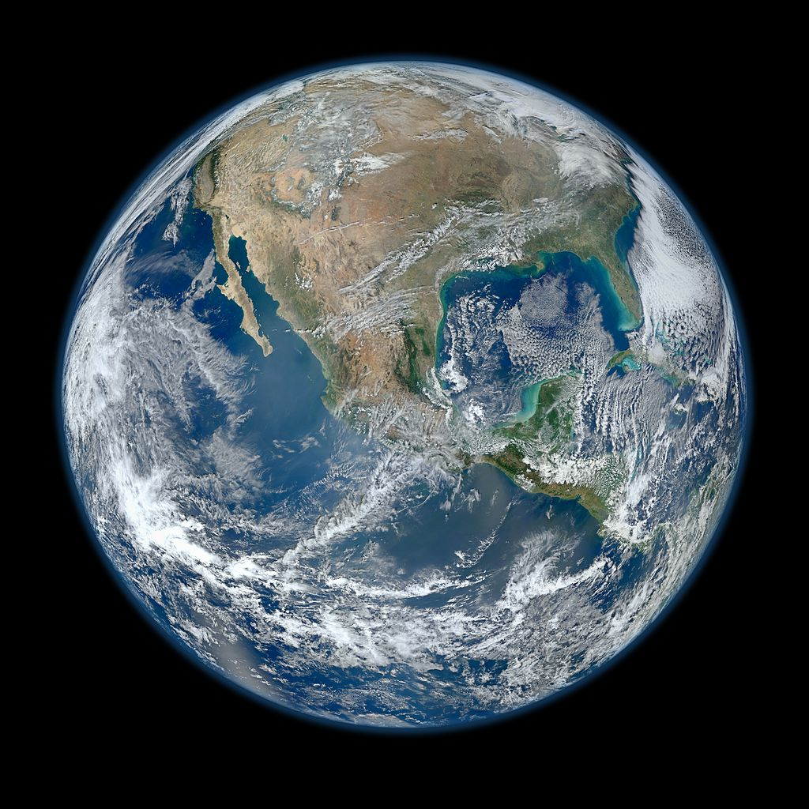
Changing to Shared Values
Notes:
A color image of Earth, North America, as seen by NASA. Wikipedia

